Slide 1
AZ-300T01 M 1: Managing Azure Subscriptions and Resources
Exploring Monitoring Capabilities in Azure
Azure Alerts
Azure Activity Logs
Introduction to Log Analytics
Querying and Analyzing Log Analytics Data

Slide 2
Lesson 1: Exploring Monitoring Capabilities in Azure
Introducing Azure Monitoring Services
Video: An Overview of Azure Monitor
Azure Monitor: Key Capabilities
Video: Centralized Monitoring with Azure Monitor
Azure Advisor

Slide 3
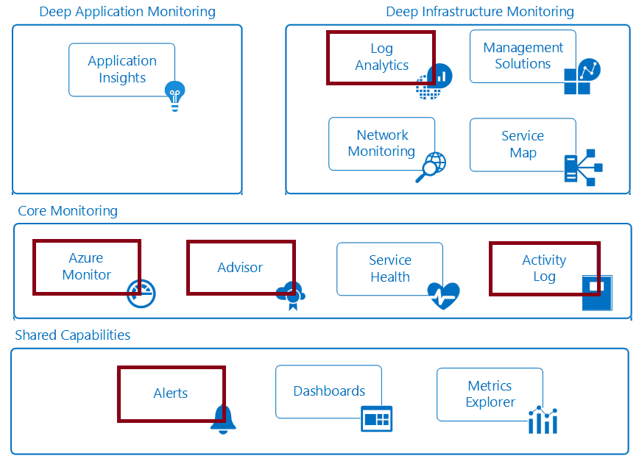
Introducing Azure Monitoring Services
Monitoring: act of collecting and analyzing data to determine performance, health, and availability of your workloads.
Azure offers a comprehensive monitoring solution that provides:
Core Monitoring
Deep Infrastructure Monitoring
Deep Application Monitoring
Shared Monitoring Capabilities

Slide 4
Video: An Overview of Azure Monitor

Slide 5
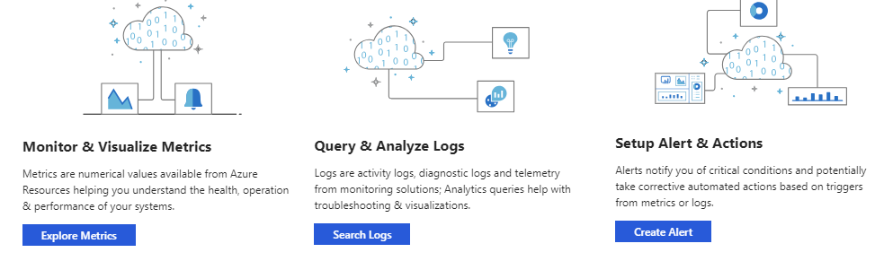
Azure Monitor: Key Capabilities
Azure core monitoring consists of collection of:
Metrics:
Represent performance statistics of Azure resources
Include operating system metrics of Azure VMs
Are available in 1 minute intervals (suitable for critical alerts and notifications)
Activity logs
Diagnostic logs

Slide 6
Video: Centralized Monitoring with Azure Monitor

Slide 7
Azure Advisor
Personalized cloud service for optimizing Azure deployments:
Analyzes resource configuration and usage telemetry
Offers recommendations grouped in four categories:
High availability: To ensure and improve the continuity of your business-critical applications.
Security: To detect threats and vulnerabilities that might lead to security breaches.
Performance: To improve the speed of your applications.
Cost: To optimize and reduce your overall Azure spending.

Slide 8
Lesson 2: Azure Alerts
Azure Monitor Alerts
Alert Rules
Action Groups
Signal Types and Metrics
Practice: Alerts

Slide 9
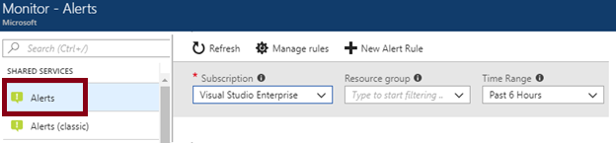
Azure Monitor Alerts
Azure Monitor supports alerts, including a range of benefits:
Improved notification system through action groups
Separation of fired alerts and alert rules
A unified authoring experience
Enhanced workflow
Access to Log Analytics alerts directly from the Azure portal

Slide 10
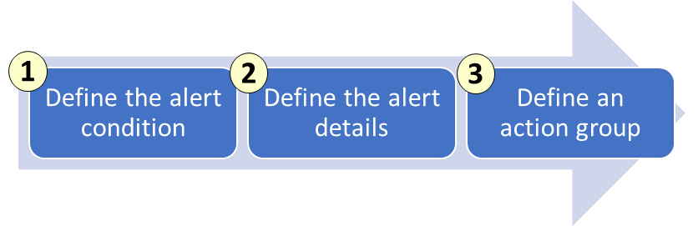
Alert Rules
Creating an alert is a three-step task:
1. Define the alert condition:
Target selection: e.g. an Azure Storage account.
Alert criteria: e.g. Used Capacity.
Alert logic: e.g. over a six-hour period whenever the Used Capacity is over 1000000 bytes.
2. Define alert details:
Alert rule name
Alert rule description
Alert severity (between 0 and 4).
3. Define an action group:
notify via email and text messages, or trigger an action by using webhooks and runbooks

Slide 11
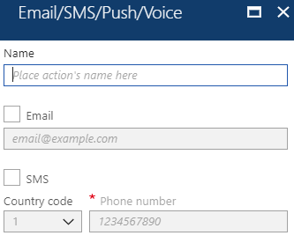
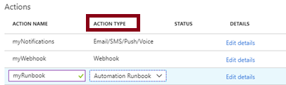
Action Groups
Action groups facilitate configuring actions in response to an alert:
Email/SMS/Push/Voice
Logic App
Webhook
Automation Runbook
IT Service Management

Slide 12
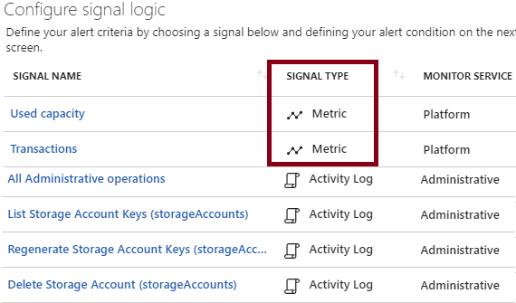
Signal Types and Metrics
Signals are emitted by target resources and include:
Metrics
Activity log
Application Insights
Logs
The latest metrics alerts offer:
Improved latency
Support for multi-dimensional metrics
More control over metrics conditions
Combined monitoring of multiple metrics
Metrics from Logs (limited public preview)

Slide 13
Practice: Alerts
Create an alert under Monitoring and send an sms to your telephone and show hot it works in the background to inform people.
It is also possible to create a logic app and take further actions

Slide 14
Lesson 3: Azure Activity Logs
Overview of Activity Log
Video: Activity Log
Query the Activity Log
Event Categories
Activity Log and Log Analytics
Collect Across Subscriptions
Video: Activity Log Alerts
Practice: Activity Log

Slide 15
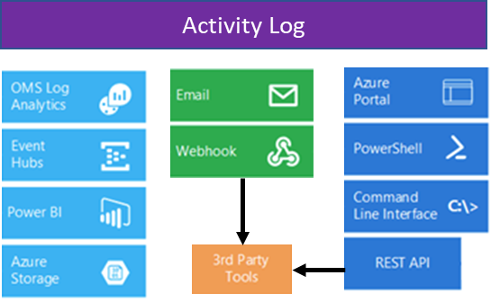
Overview of Activity Log
A subscription-level log that captures:
Azure Resource Manager operational data (control plane)
Service Health events
Includes audit trail of all write/change operations:
Helps determine “what, who, and when”
Provides the status of each operation
Its content can be:
Streamed to Event Hub.
Analyzed with Power BI.
Viewed in the Azure portal.
Forwarded to Log Analytics.
Archived in an Azure Storage account.
Processed with PowerShell, CLI, and REST API.

Slide 16
Video: Activity Log

Slide 17
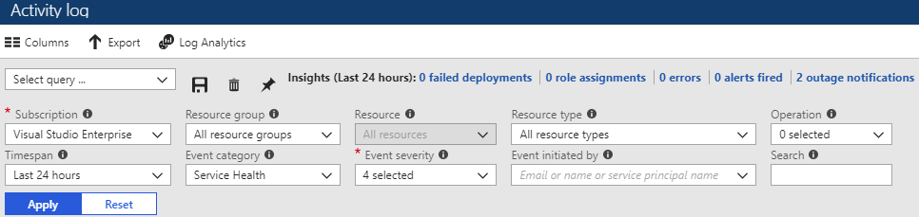
Query the Activity Log
Available directly from the Azure portal, with filtering based on:
Subscription
Resource group
Resource (name)
Resource type
Operation (type)
Timespan
Event category
Event severity
Event initiated by
Filter selection can be saved
Queries can be pinned to the Azure portal dashboard

Slide 18
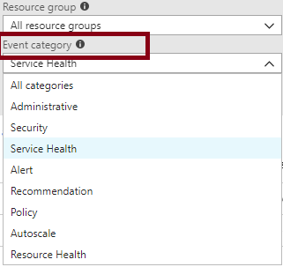
Event Categories
Administrative
Security
Service Health
Alert
Recommendation
Policy
Autoscale
Resource Health

Slide 19
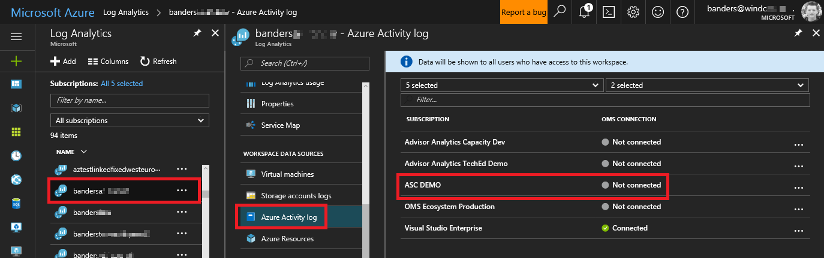
Activity Log and Log Analytics
Activity log can be added to Azure Log Analytics workspace:
Can be in the same or a different subscription (if it has the same Azure AD tenant)
Provides the ability to:
Correlate user activities, auto-scale operations, authorization changes, and service health to other logs or metrics from your environment.
Correlate activity logs with other Azure services and application data.
Analyze and search activity logs from multiple Azure subscriptions.
Keep activity logs for longer than the default of 90 days.
View operational activities aggregated by status.
Analyze activity logs with pre-defined views.
Identify outage or service health issues.
Report on authorization changes.
View trends of activities.

Slide 20
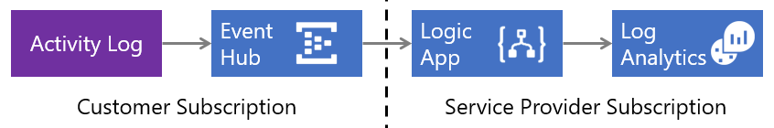
Collect Across Subscriptions
You can collect Azure Activity Logs into a Log Analytics workspace using the Azure Log Analytics Data Collector connector for Logic Apps
This facilitates using a workspace in a subscription that has a different Azure AD tenant
It offers a number of advantages, including:
Low latency, since the Azure Activity Log is streamed into the Event Hub
Serverless services, with no infrastructure components to deploy
Minimal custom code

Slide 21
Video: Activity Log Alerts

Slide 22
Practice: Activity Log

Slide 23
Lesson 4: Introduction to Log Analytics
Video: Log Analytics
Log Analytics Scenarios
Create a Workspace
Connected Sources
Data Sources
Demonstration: Log Analytics
Practice: Visualize Data
Practice: Alert on Data

Slide 24
Video: Log Analytics

Slide 25
Log Analytics Scenarios
Scenario 1 – Assessing updates:
Core functionality:
Identifying system update requirements
Planning update deployment
Extra benefits:
Log Analytics collects customer data globally and provides an average duration of deployment
Scenario 2 – Change tracking:
Base functionality:
Tracking operational changes
Extra benefits:
Simplified troubleshooting of operational incidents
Evidence of security breaches
Correlation of changes in loosely coupled applications
Help with detection of unusual behavior, such as installations of unapproved software or unexpected system reboots or shutdowns

Slide 26
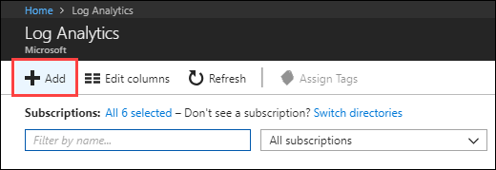
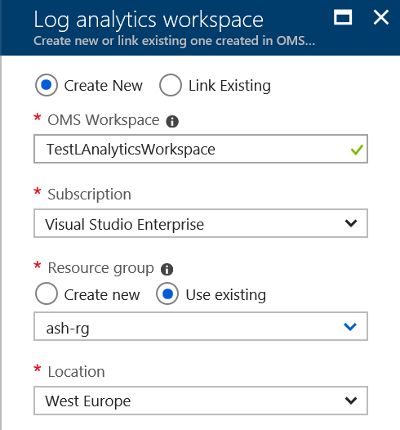
Create a Workspace
Start by creating a Log Analytics workspace

Slide 27
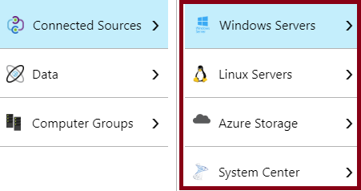
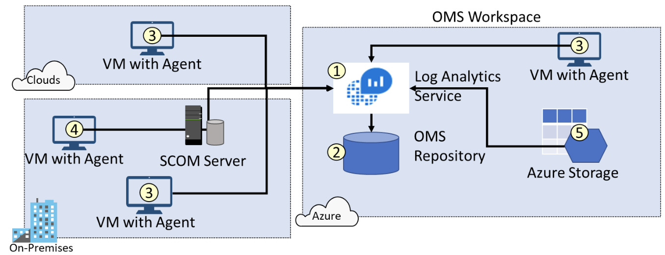
Connected Sources
Include:
Windows and Linux servers:
Connected directly by installing Log Analytics agent
Connected as members of a SCOM management group
Azure Storage
Generate data flow:
1. Log Analytics agent collects data
2. Data is stored in OMS Repository
3. Agents run on Windows and Linux on-premises and in public clouds
4. Adding SCOM management group to Log Analytics automatically adds to the workspace all of their computers
5. Log Analytics collects storage logs

Slide 28
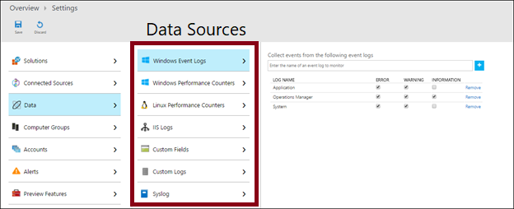
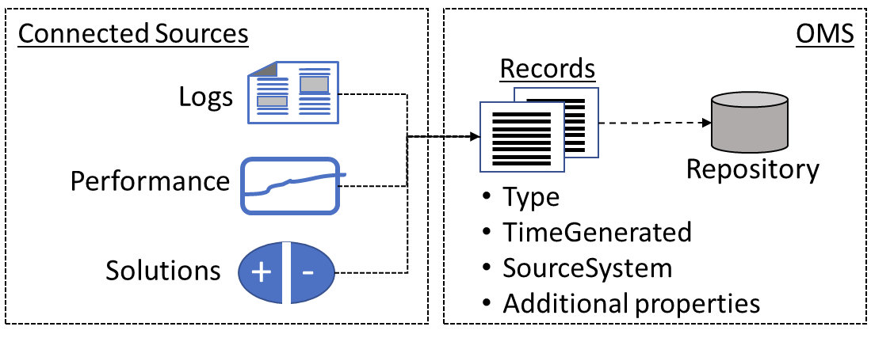
Data Sources
Types of collected data:
Windows Event Logs
Error
Warning
Informational
Windows Performance Counters
Linux Performance Counters
IIS logs
Custom fields
Custom logs
Syslog
You select a data source:
Connected source-specific
Data collection is automatic

Slide 29
Demonstration: Log Analytics

Slide 30
Practice: Visualize Data
Let’s collect some data

Slide 31
Practice: Alert on Data

Slide 32
Lesson 5: Querying and Analyzing Log Analytics Data
Analyzing Log Analytics Data
Practice: Collect and Analyze Data
Log Analytics Querying
Querying Language Syntax
Demonstration: Log Analytics Querying
Practice: Log Analytics Queries

Slide 33
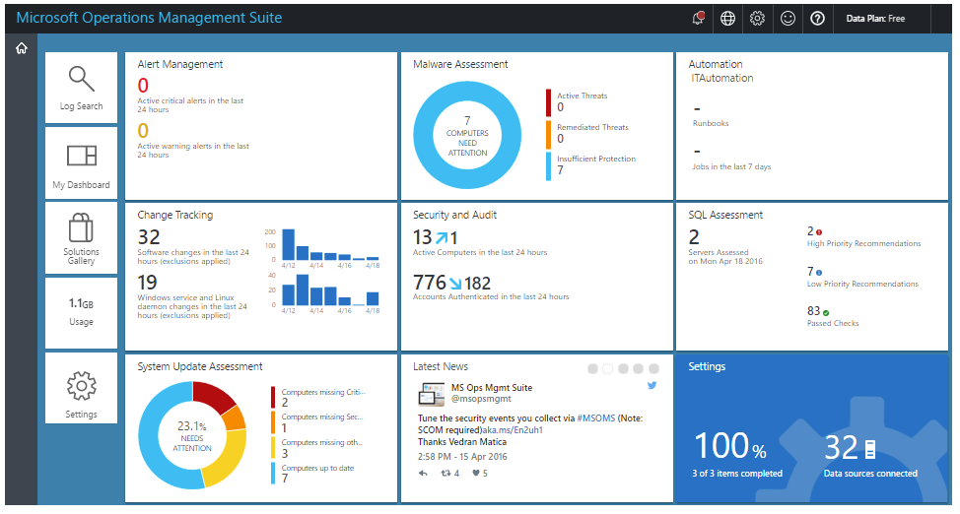
Analyzing Log Analytics Data
The OMS portal:
Legacy interface
To be deprecated
The Azure portal:
Current interface
Includes OMS capabilities:
Log searches
Dashboards
Solutions

Slide 34
Practice: Collect and Analyze Data
Let’s Analyse Data together

Slide 35
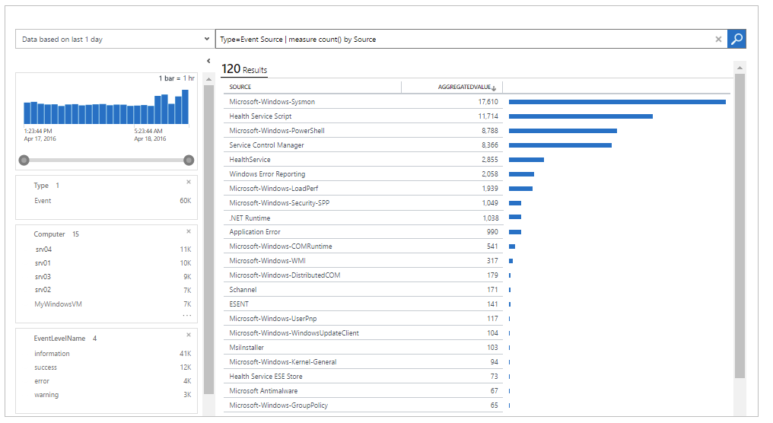
Log Analytics Querying
Log Analytics queries:
Facilitate data retrieval, aggregation, and analysis
Can be saved and used to populate dashboards
Generate data sets for exporting to external tools:
Power BI
Excel
Can be used to generate alerts
Are available via Log Search API

Slide 36
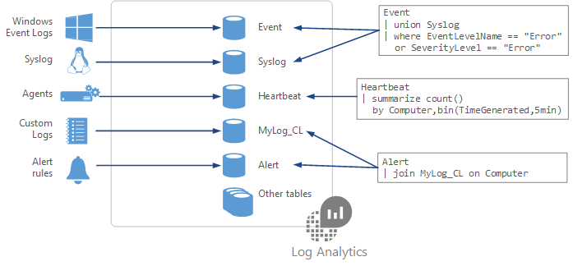
Querying Language Syntax
Each data source and solution stores data in dedicated tables in the Log Analytics workspace.
The primary query tables are:
Event
Syslog
Heartbeat
Alert
Query syntax includes:
A source table
A series of operators
Pipe characters

Slide 37
Demonstration: Log Analytics Querying

Slide 38
Practice: Log Analytics Queries

